Slide 1

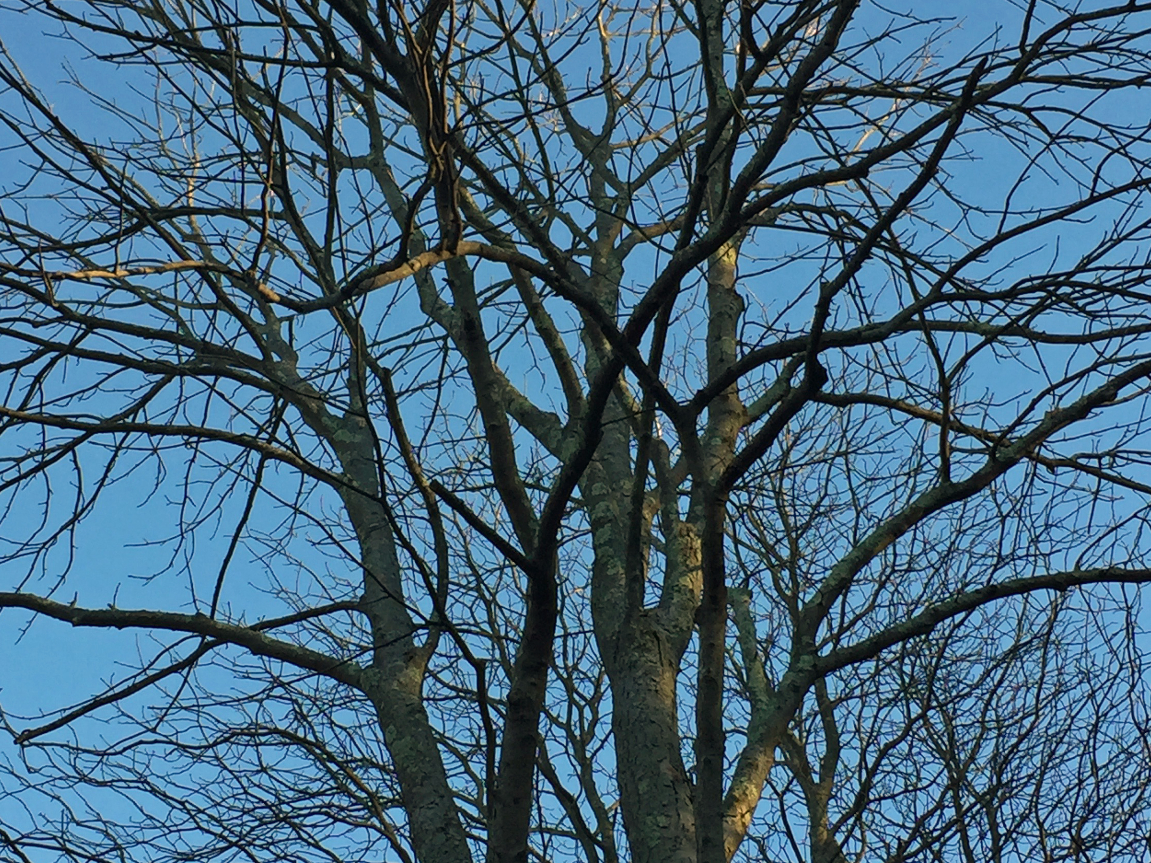
What is the relationship between late spring freezing events and the duration of vegetative risk?
Freezing experiment and future directions

Slide 2
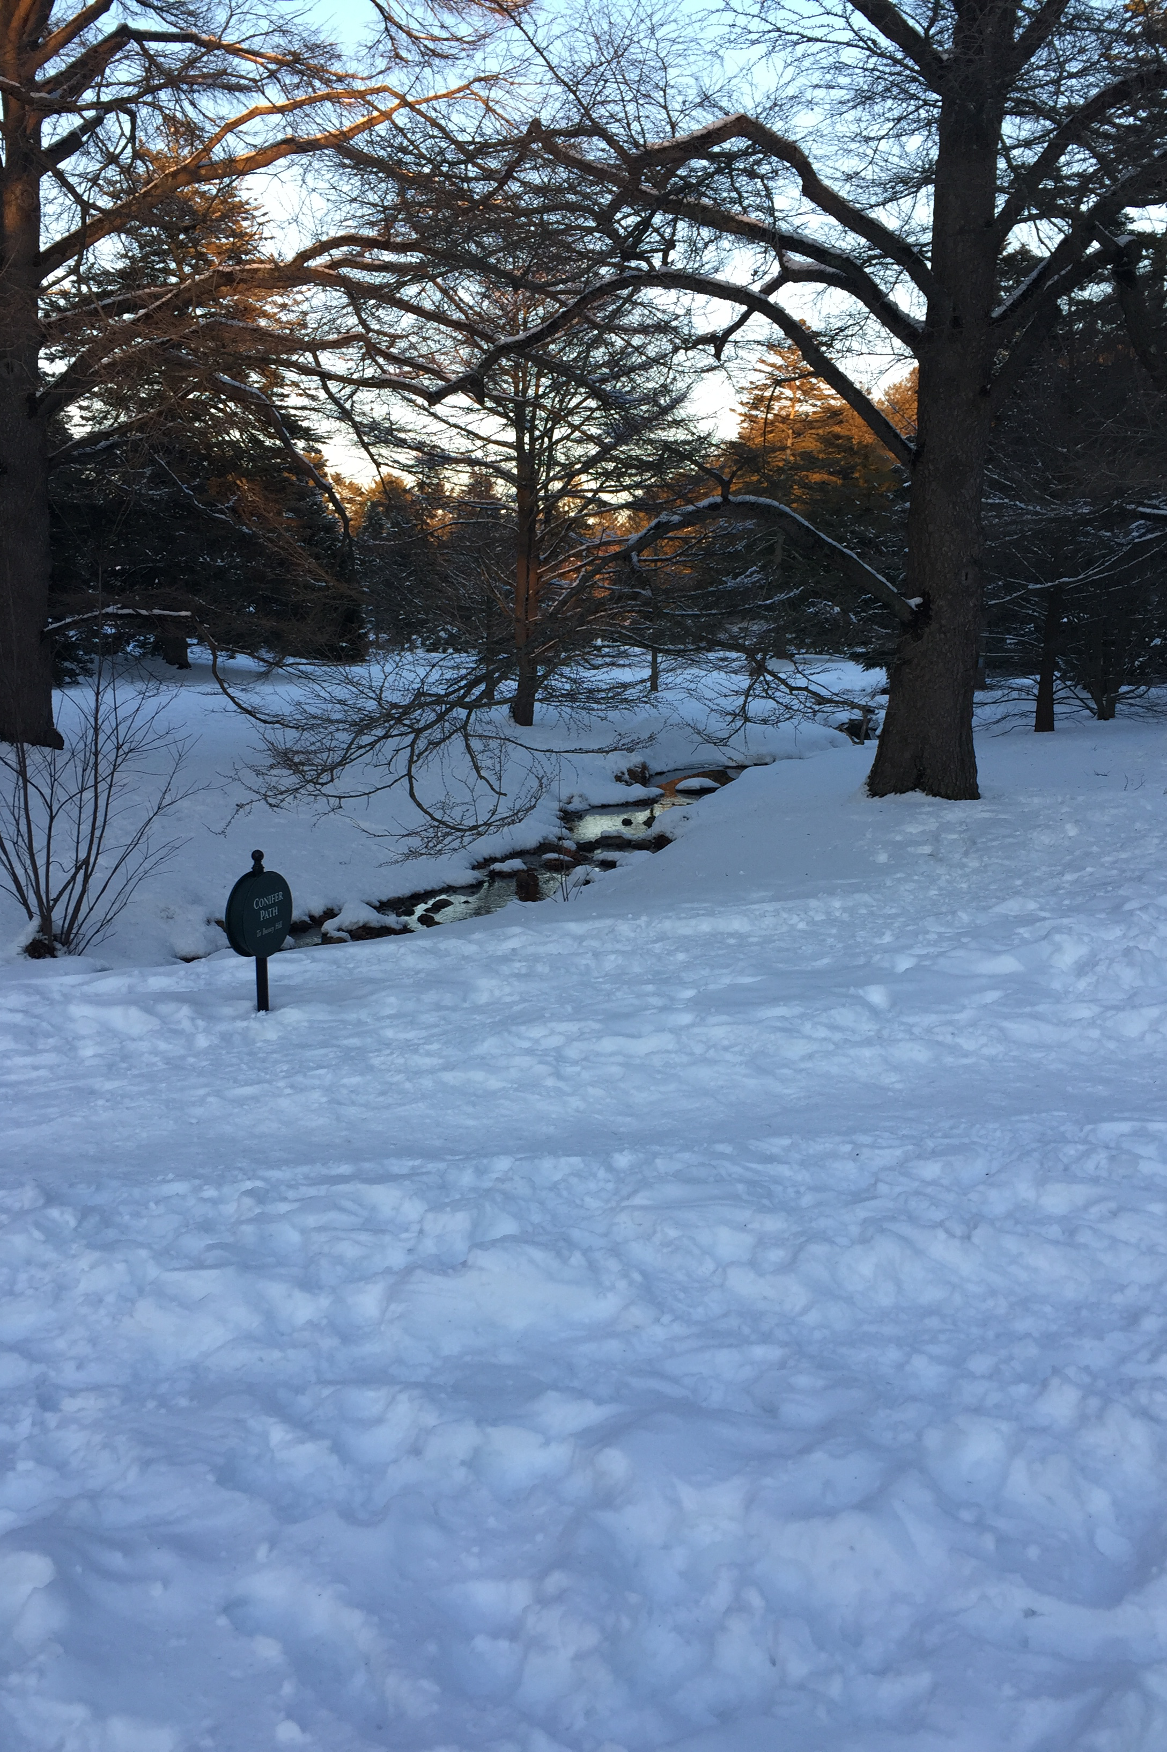
Outline
Brief Background
Experiment
Methods
Results
Next Steps
Future Directions

Slide 3
KEY TERMS
False Spring: freezing temperatures AFTER budburst has been initiated
Duration of Vegetative Risk: the time between budburst and leafout
Hard Frost: -2.2℃
Soft Frost: -1.7℃
Theme Song: “Ice Ice Baby” by Vanilla Ice

Slide 4
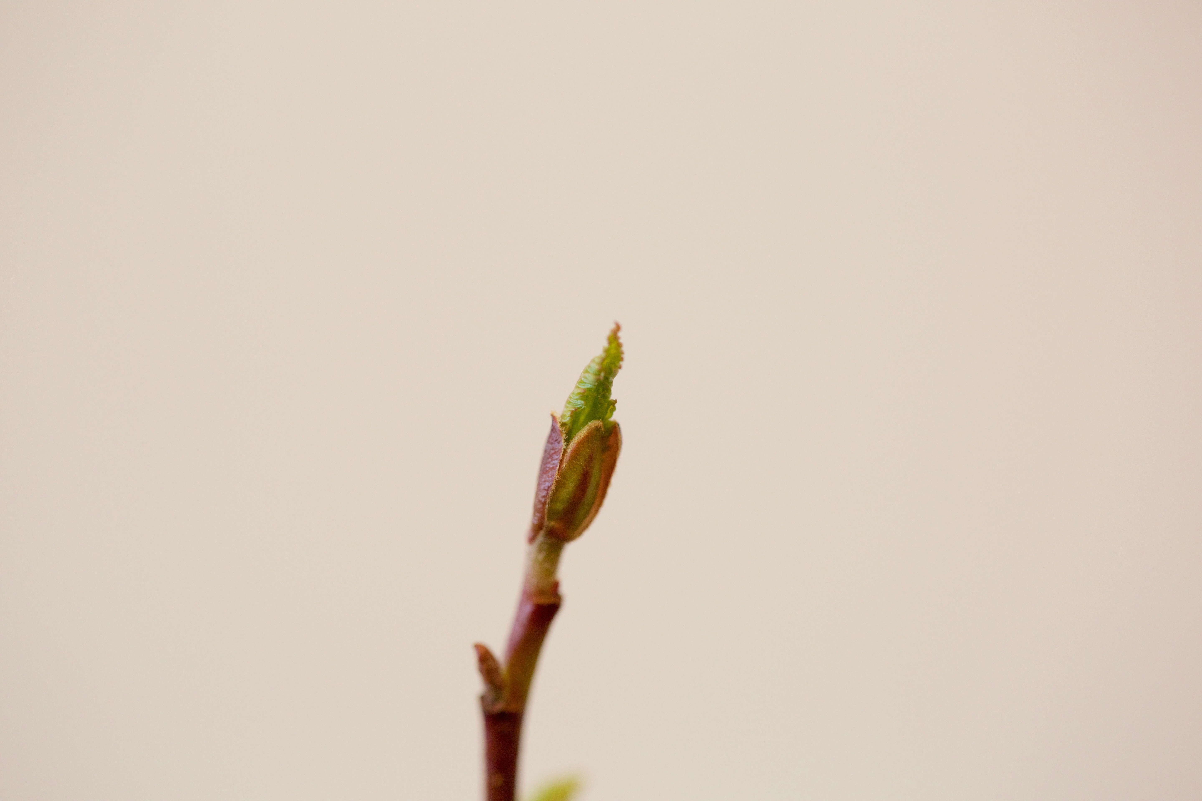
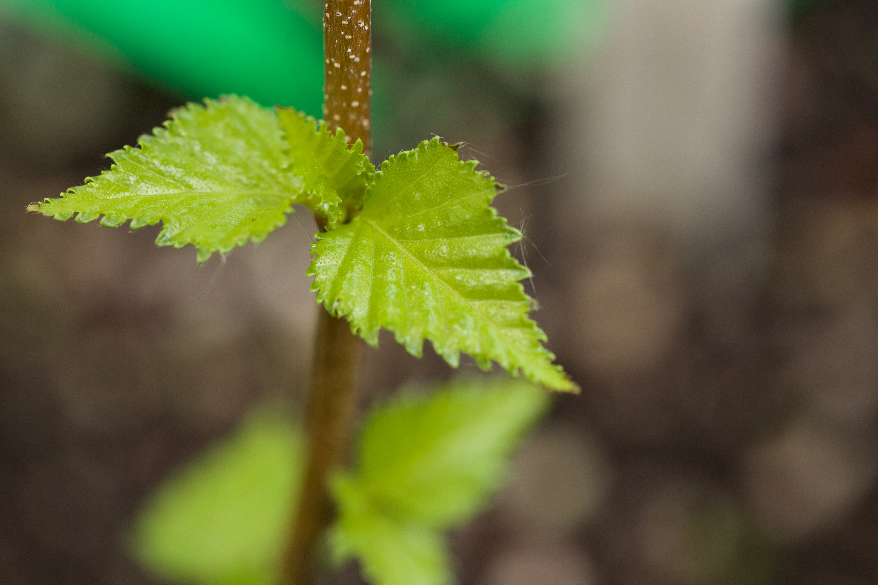
Alnus incana - bud burst (BBCH 9)
Where’s the risk?
Just a Reminder…
Interested in time between BBCH Stage 9 and BBCH Stage 15
BUD BURST
LEAF OUT
FREEZE TIME!
Lenz et al., 2013
Betula populifolia - leaf out (BBCH 14)

Slide 5
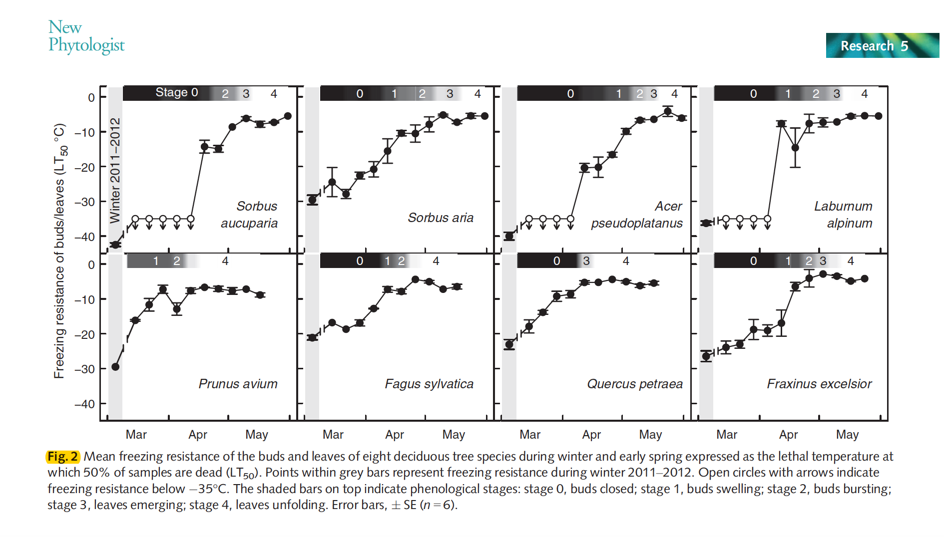
Lenz et al., 2013
Notes:
“The phenological stage of each sampled bud was recorded on a
categorical scale according to Vitasse et al. (2013), namely bud
closed (stage 0), bud swelling (stage 1), bud burst (stage 2), leaf
emergence (stage 3) and leaf unfolding (stage 4)”

Slide 6
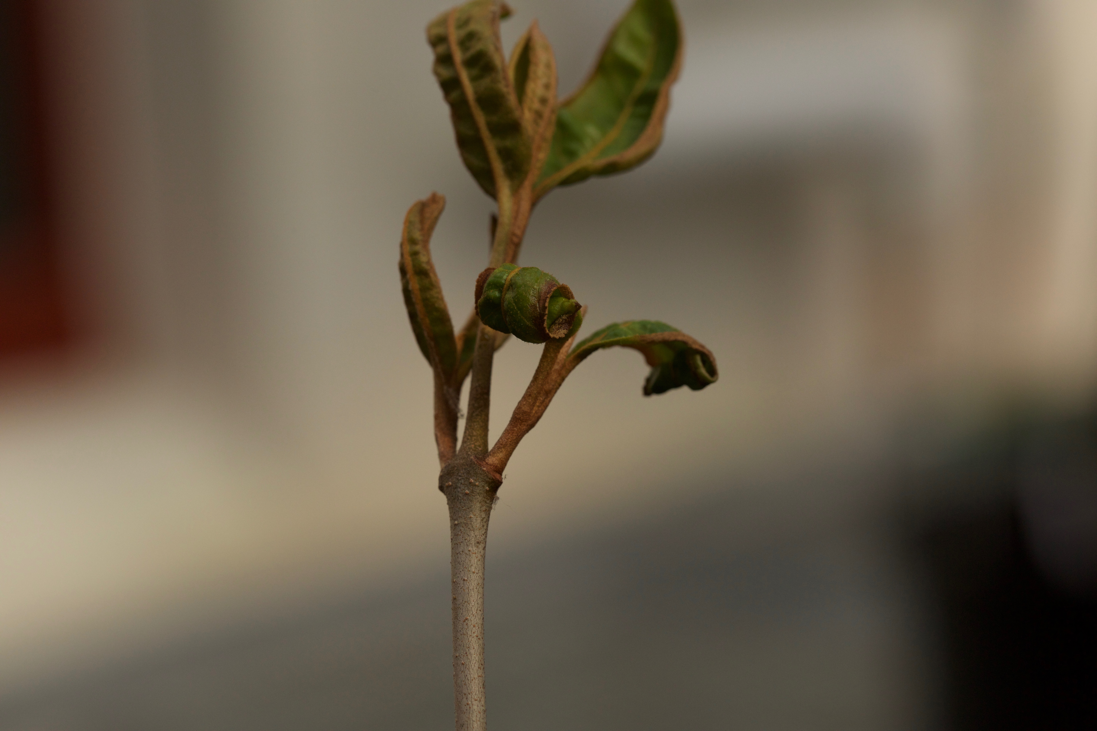
Duration of Vegetative Risk
Plants are most susceptible to damage during this time
Possible ecological indicator of potential risk for species, habitat type, and region
Notes:
Plants are most susceptible to frost damage between budburst and leafout (Lenz et al. , 2016; Vitasse et al. ,
2014; Augspurger, 2009). The rate of budburst and the length of time between budburst and leafout is a
crucial indicator for predicting level of damage from a false spring event. We will refer to the timing of
these collective phenophases (i.e. budburst to leafout) as the duration of vegetative risk. The duration of
vegetative risk generally is extended if a freezing event occurs during the phenophases between budburst
and leaf expansion and species with short durations of vegetative risk often sustain higher levels of damage.
Therefore, if the duration of vegetative risk is longer, then the buds and leaves will be heartier against frosts,
however this still has yet to be tested thoroughly (Augspurger, 2009). Frost tolerance, however, steadily
decreases after budburst begins until the leaf is fully unfolded, with leafout being the most susceptible to
6
frost damage (Lenz et al. , 2016). It is therefore crucial

Slide 7
Duration of Vegetative Risk (cont…)
Theories:
If duration of vegetative risk is longer, than buds and leaves of that species are heartier against frosts (Augspurger, 2009).
Level of damage incurred increases as duration of vegetative risk increases (Lenz, 2016).
Notes:
Plants are most susceptible to frost damage between budburst and leafout (Lenz et al. , 2016; Vitasse et al. ,
2014; Augspurger, 2009). The rate of budburst and the length of time between budburst and leafout is a
crucial indicator for predicting level of damage from a false spring event. We will refer to the timing of
these collective phenophases (i.e. budburst to leafout) as the duration of vegetative risk. The duration of
vegetative risk generally is extended if a freezing event occurs during the phenophases between budburst
and leaf expansion and species with short durations of vegetative risk often sustain higher levels of damage.
Therefore, if the duration of vegetative risk is longer, then the buds and leaves will be heartier against frosts,
however this still has yet to be tested thoroughly (Augspurger, 2009). Frost tolerance, however, steadily
decreases after budburst begins until the leaf is fully unfolded, with leafout being the most susceptible to
6
frost damage (Lenz et al. , 2016). It is therefore crucial

Slide 8
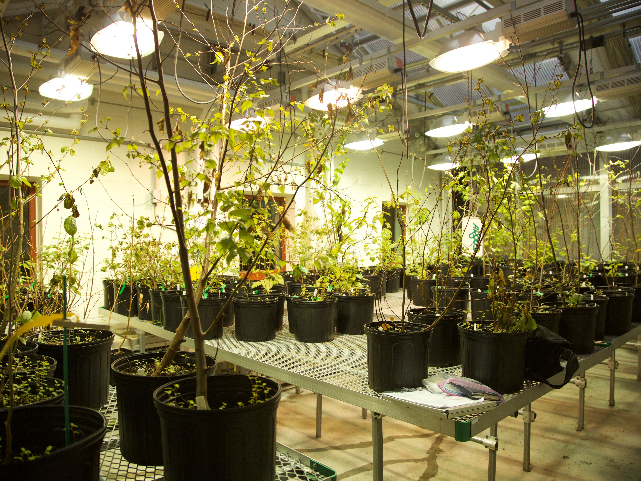
EXPERIMENT

Slide 9
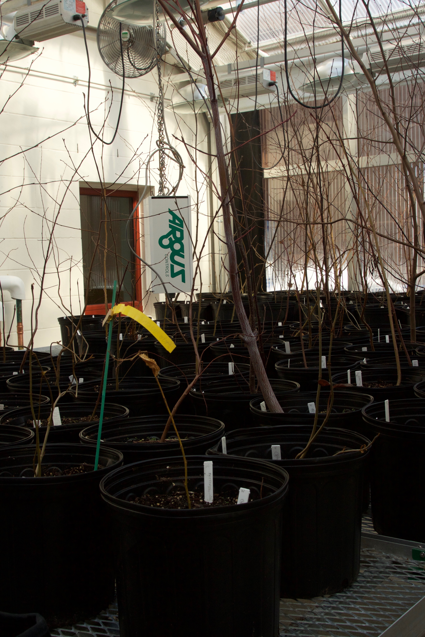
Breakdown
Three Treatments:
A) Control Group
B) Freeze Group
C) Drought + Freeze Group
Species:
ACEPEN
ALNINC
BETALL
BETPOP
CORCOR
PRUPEN
VIBCAS

Slide 10
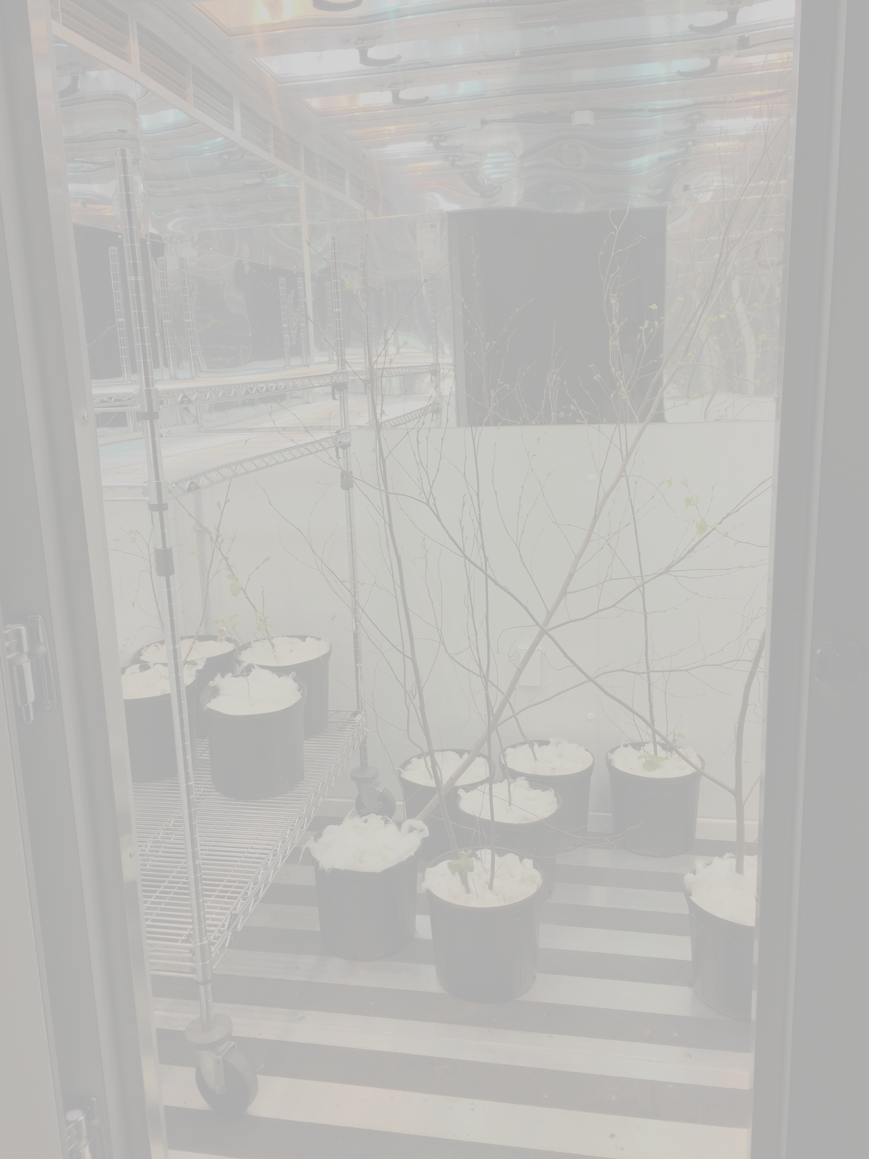
False Spring
Greenhouse: ~58℃, 86% humidity, 12-hour photoperiod
Recorded BBCH Stage every ~3 days
Groups B & C put in Growth Chamber between stages 10-12 for 24 hours
Growth Chamber: -3℃, 12-hour photoperiod

Slide 11
Results
Drought:
lm(formula = percent ~ TX, data = soil)
coef.est coef.se
(Intercept) 64.47 0.47
TXB 0.17 0.71
TXC -2.92 0.65
---
n = 56, k = 3
residual sd = 2.09, R-Squared = 0.34

Slide 12
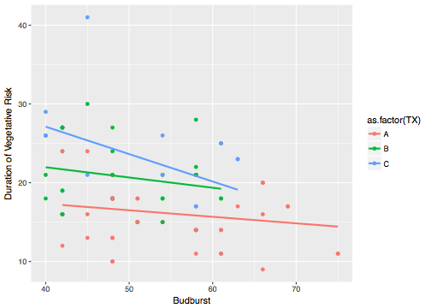
Treatment Effect

Slide 13
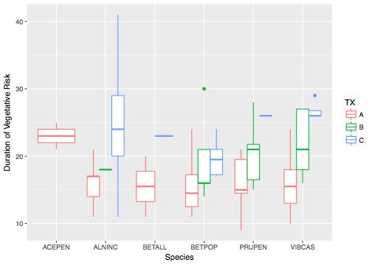
Species by Treatment

Slide 14
Results (cont.)
lm(formula = Risk ~ TX, data = risk9)
coef.est coef.se
(Intercept) 16.10 0.74
TXB 4.69 1.16
TXC 7.28 1.40
---
n = 86, k = 3
residual sd = 4.76, R-Squared = 0.28

Slide 15
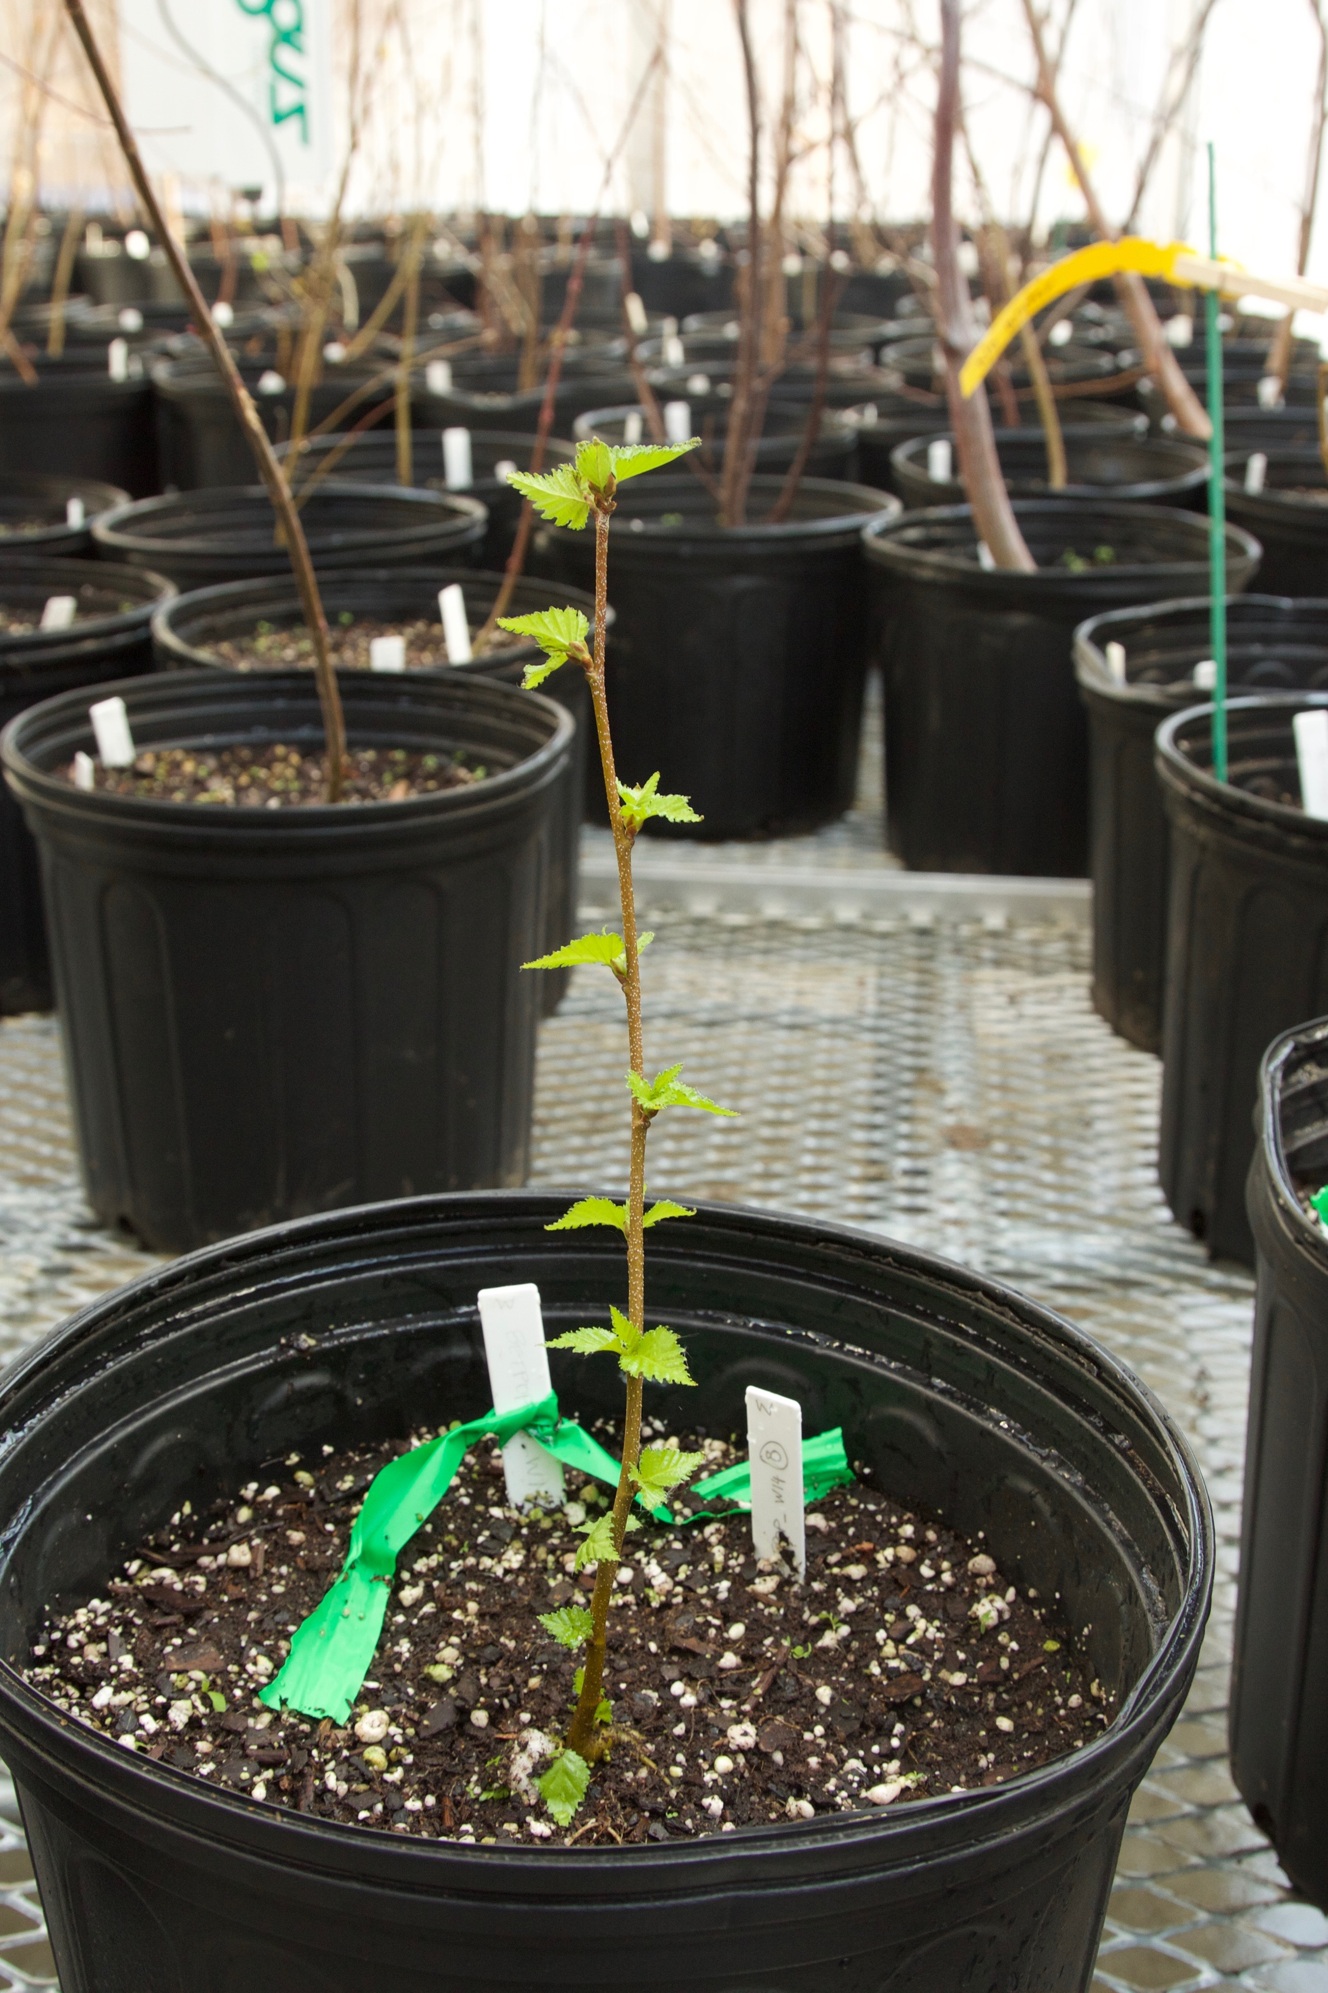
So what’s going on?
Potential Reasons…
1. Need to expend energy on repair rather than on continuing to leaf out
2. Responding to the freeze - are they learning?
Or maybe not….

Slide 16
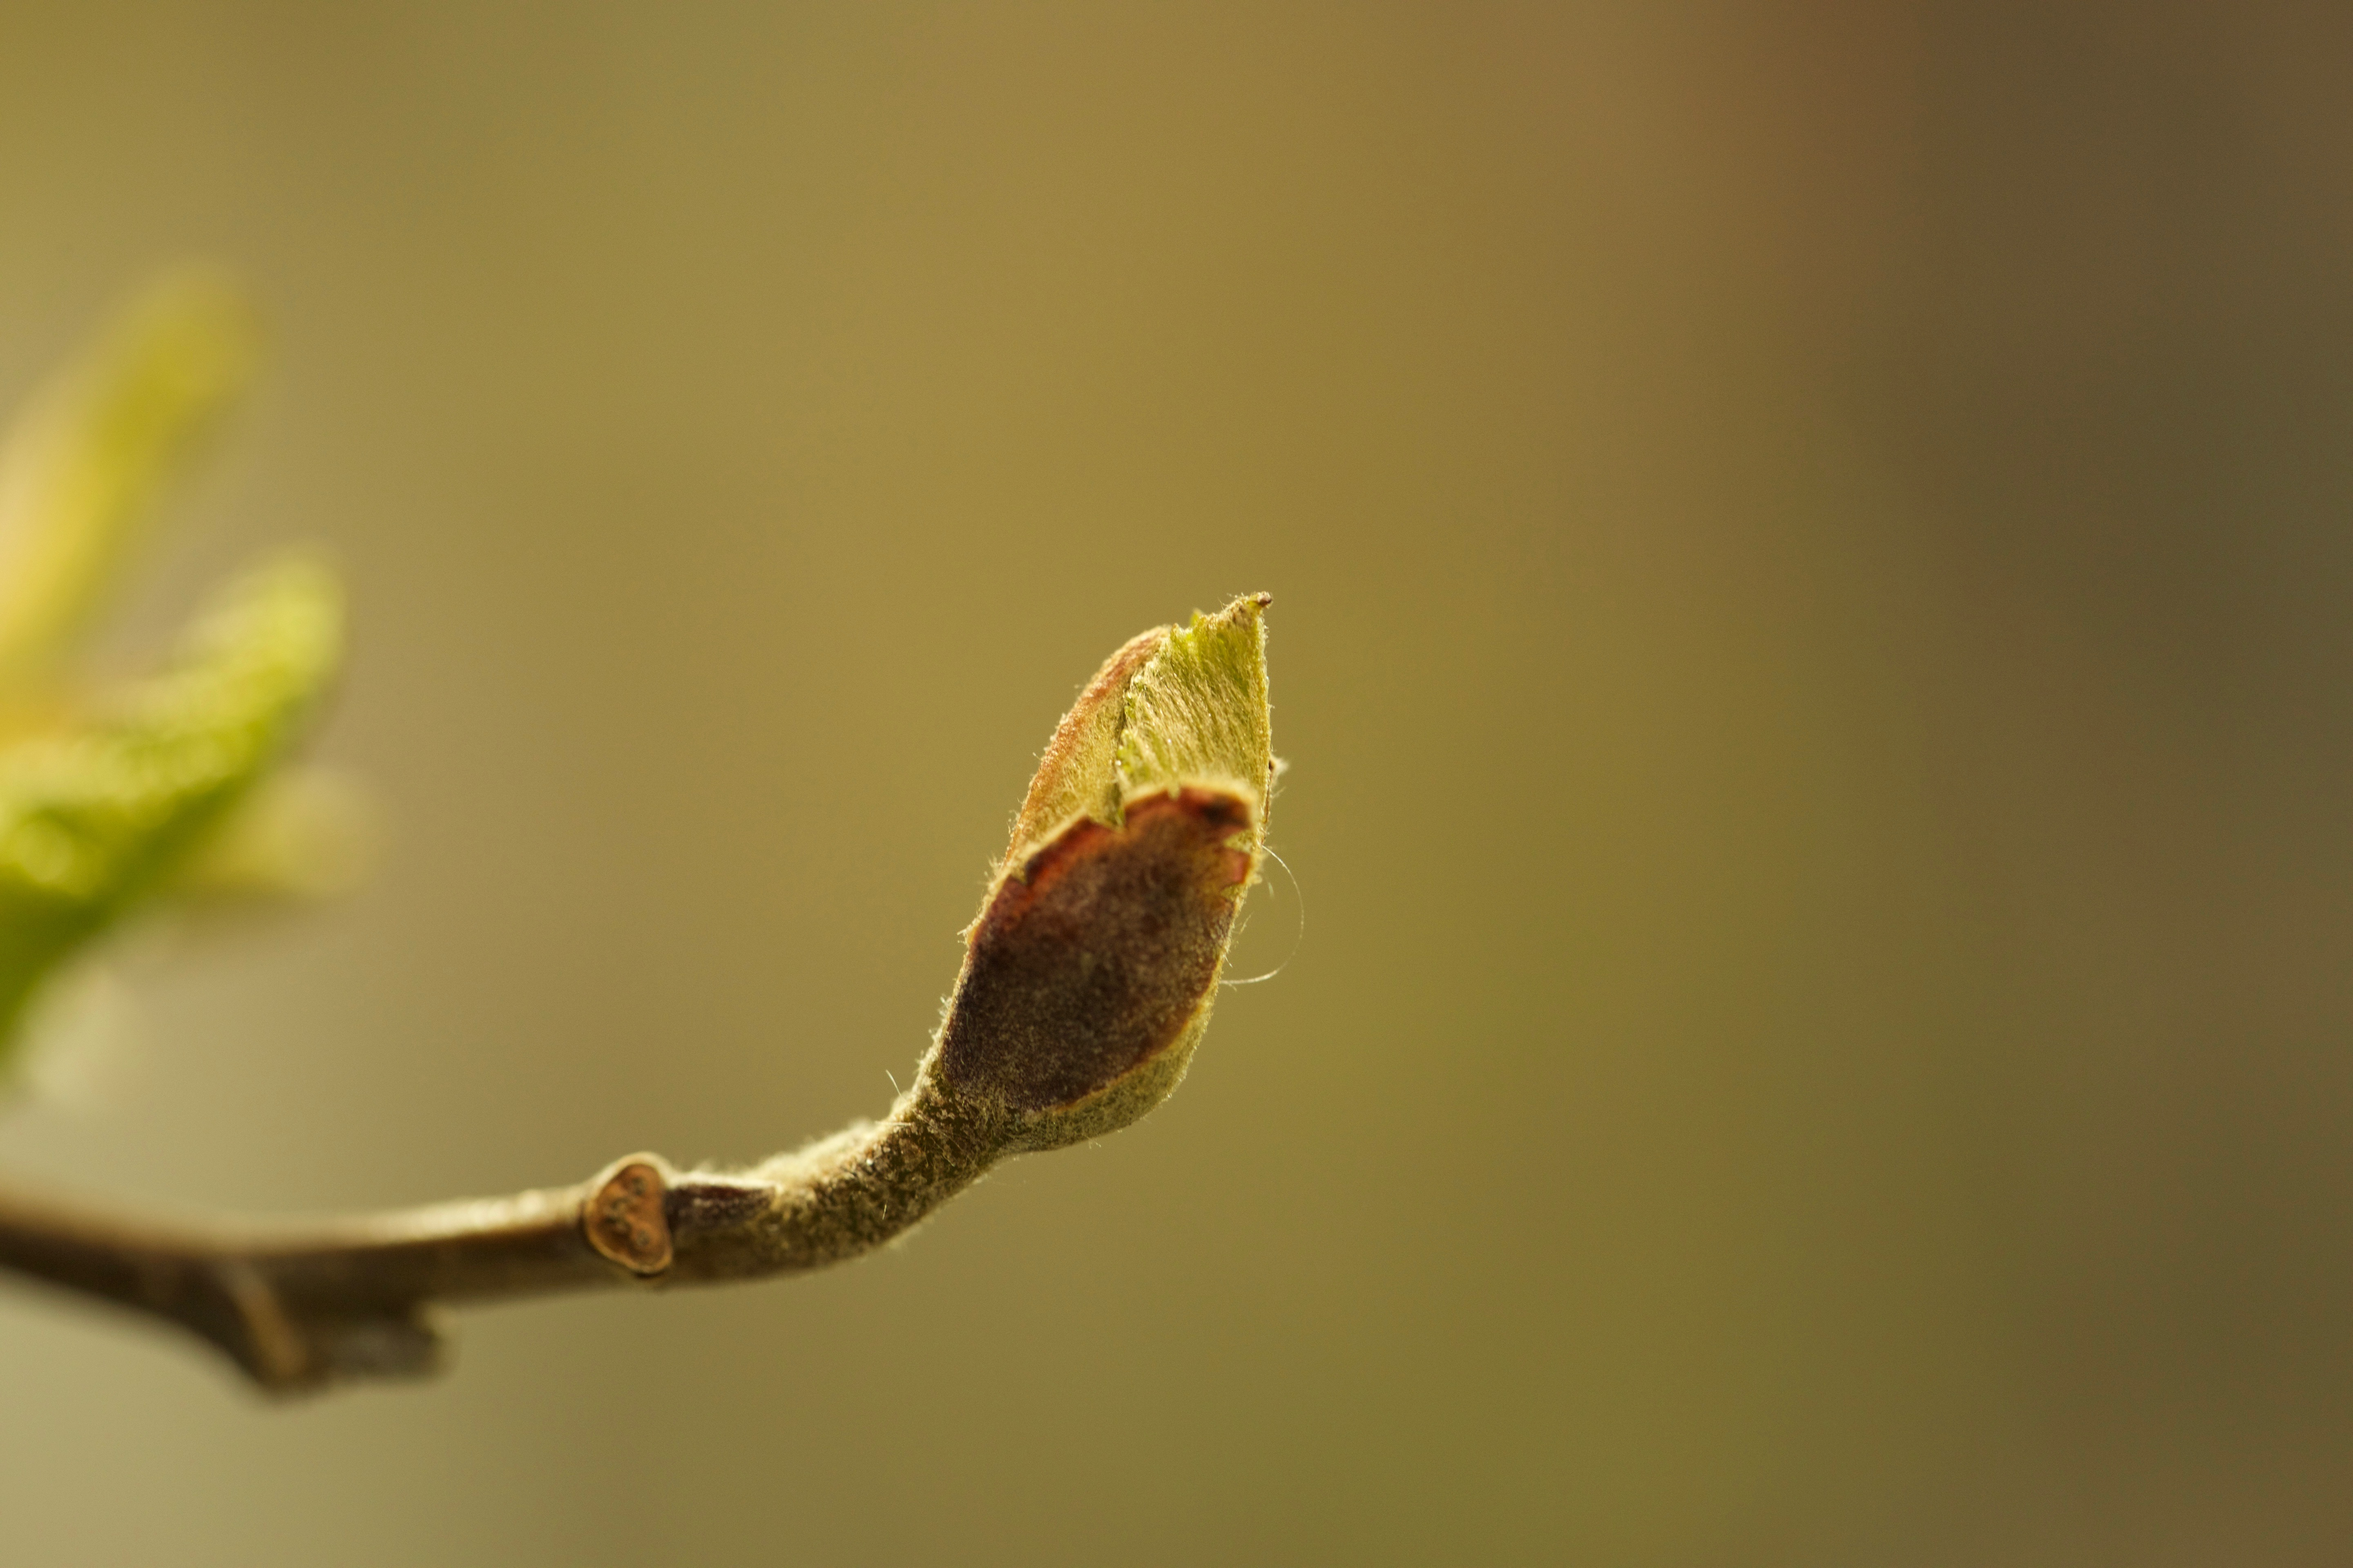
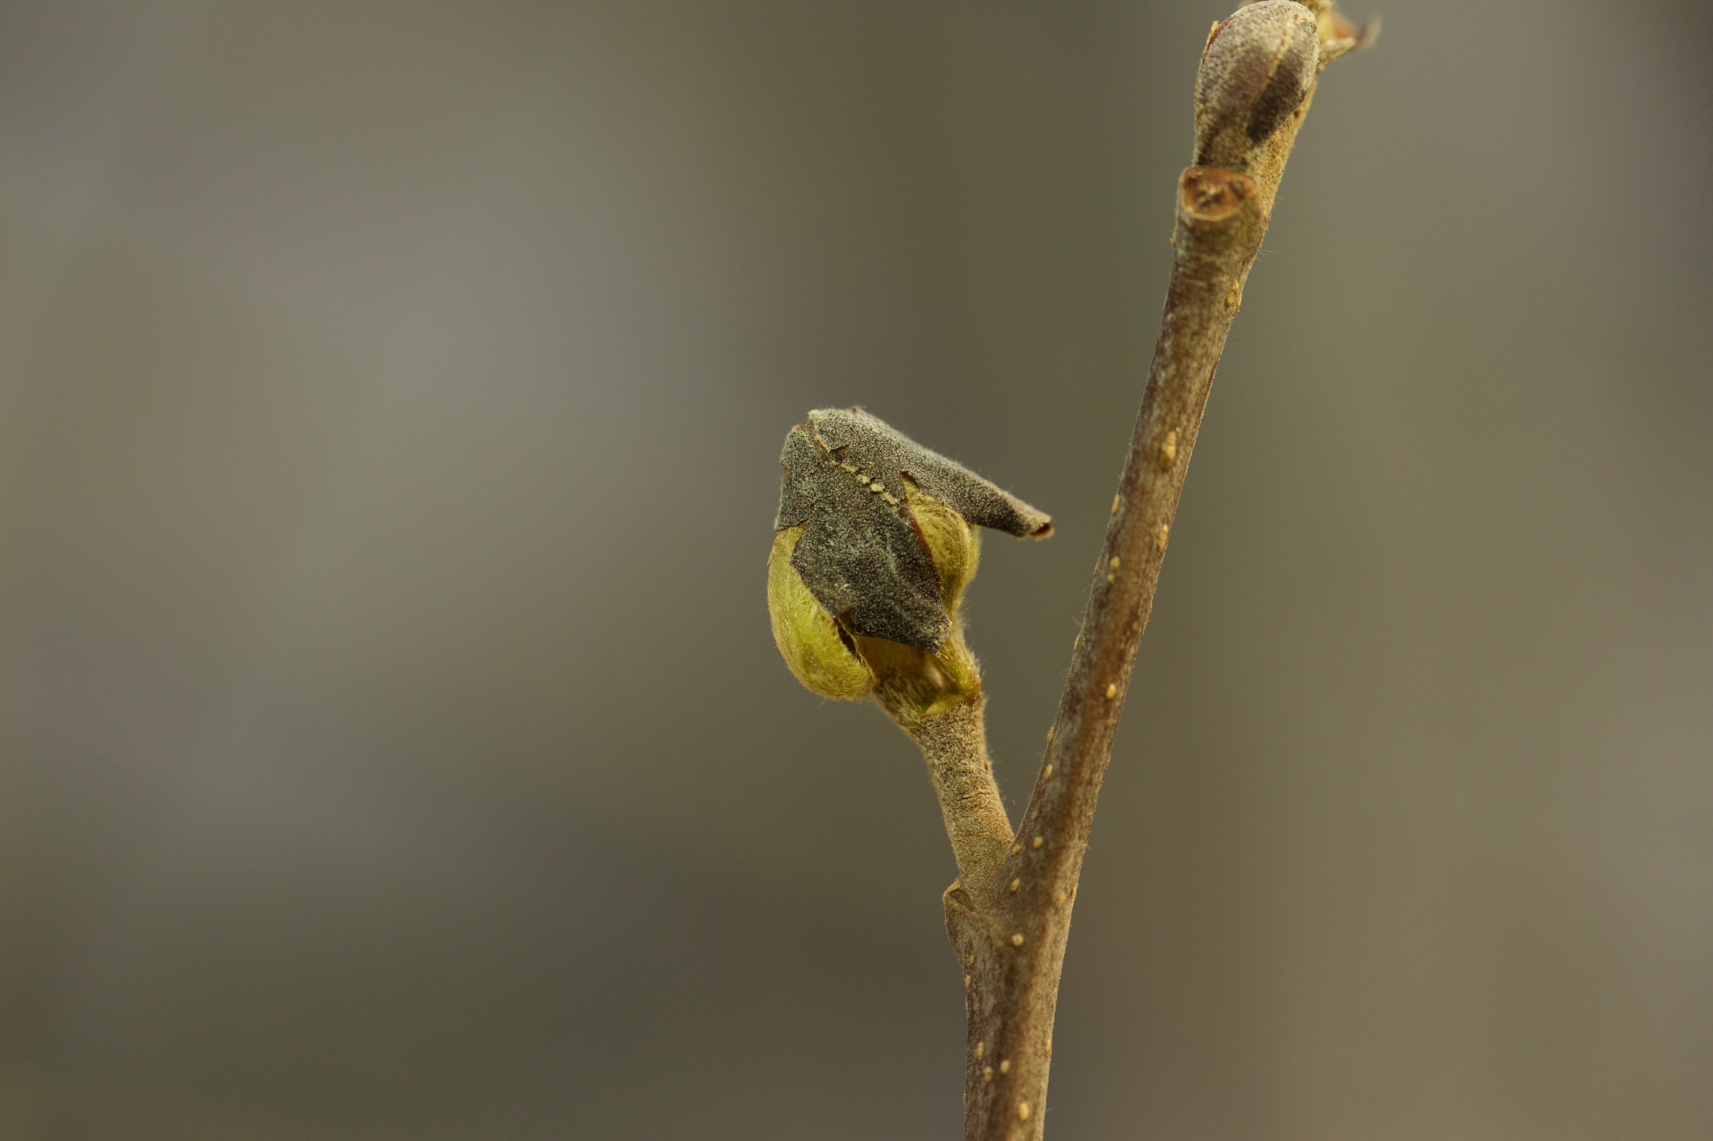
Which one was zapped?

Slide 17
Which one was zapped?

Slide 18
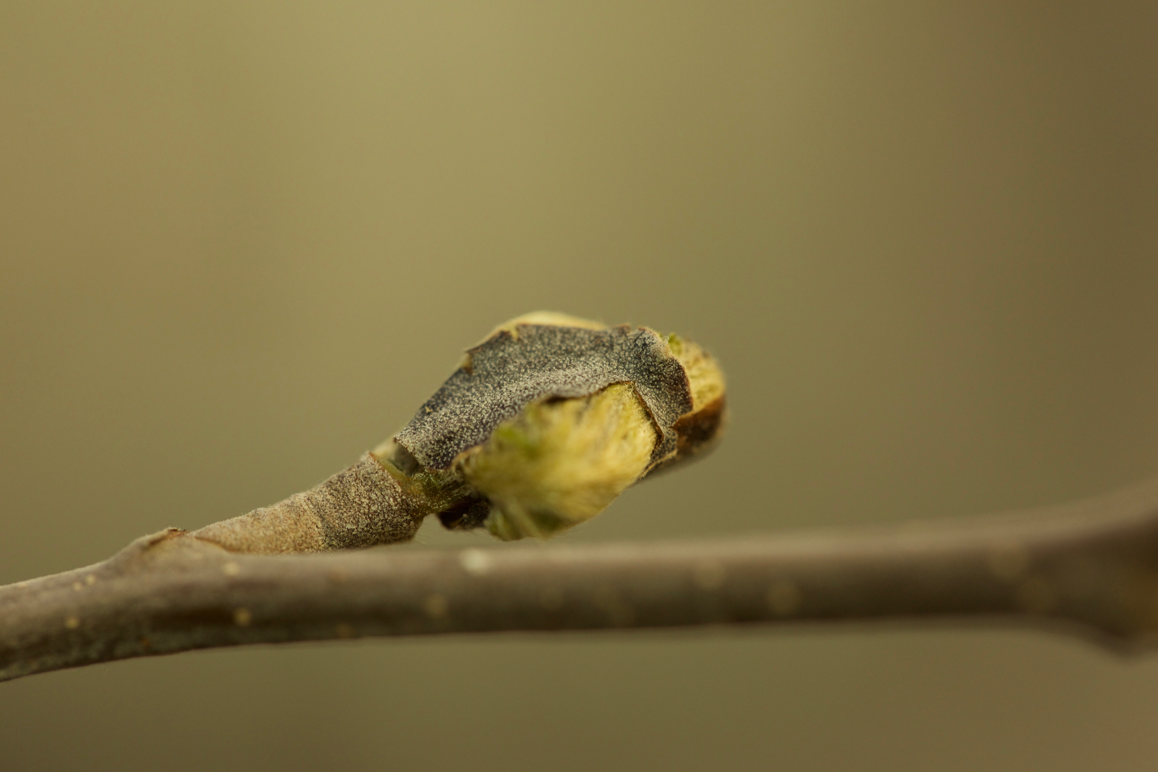

Slide 19
Future Directions
New Experiment: fewer confounding variables
SAMRAC - 18
BETPAP - 14
BETPOP - 16
What’s the story with this bud nonsense? (Kristel)
Rethinking Paper (ongoing)
Gridded Climate Layers and Precipitation prior to frost
Question for Dan - would you expect duration of vegetative risk in synanthous species to be longer?

Slide 20
Extra results…
VIBCAS
All Species
vib<- lm(Risk~TX)
Anova(vib)
mod<- lm(Risk~TX+Budburst+species)
Anova(mod)
Anova Table (Type II tests)
Response: Risk
Sum Sq Df F value Pr(>F)
TX 569.81 2 19.794 2.54e-06 ***
Residuals 460.59 32
Anova Table (Type II tests)
Response: Risk
Sum Sq Df F value Pr(>F)
TX 491.78 2 13.7139 8.044e-06 ***
Budburst 331.28 1 18.4759 4.982e-05 ***
species 369.82 5 4.1251 0.002261 **
Residuals 1380.62 77

Slide 21
species_TX | mean | sd | count
ACEPEN_A | 23 | 2.828427125 | 2
ALNINC_A | 16.33333333 | 3.082207001 | 9
ALNINC_B | 18 | 0 | 2
ALNINC_C | 25 | 12.32882801 | 4
BETALL_A | 15.5 | 6.363961031 | 2
BETALL_C | 23 | NA | 1
BETPOP_A | 15.66666667 | 4.760952286 | 6
BETPOP_B | 19.4 | 6.46529195 | 5
BETPOP_C | 19.66666667 | 2.804757862 | 6
PRUPEN_A | 16.14285714 | 4.25944329 | 7
PRUPEN_B | 20.33333333 | 4.885352256 | 6
PRUPEN_C | 26 | NA | 1
VIBCAS_A | 15.3125 | 3.700788204 | 16
VIBCAS_B | 21.8 | 4.2122271 | 15
VIBCAS_C | 26.75 | 1.5 | 4

